Slide 1
Building the Real-time Web with ASP.NET Core SignalR
Scott Addie
Senior Content Developer
@Scott_Addie

Slide 2


SignalR: The what
Started as pet project in effort to build cloud-based IDE
Rewritten in ASP.NET Core
Real-time web app model
Bi-directional HTTP communication between server & client
SignalR client
SignalR connection
SignalR server (Hub)
.NET, JS, Java
HubConnection
Unofficial:
C++, Swift
WebSockets
Server-sent events
Long polling
Notes:
2011: Work started (Damian Edwards & David Fowler)
2013: Released with ASP.NET
Inclusion in 2.1
Data typically pushed from server to clients
HubConnection = SignalR’s abstraction of a persistent connection
WebSockets = 1st choice (persistent, bi-directional connection)

Slide 3
SignalR: The why
Client: “Do you have anything for me yet?”
Server: No.
Client: “Do you have anything for me yet?”
Server: No.
Client: “Do you have anything for me yet?”
Server: Here you go.
GET /server-messages
[“Message 1”, “Message 2”]
GET /server-messages
[]
GET /server-messages
[]
GET /server-messages
[“Message 3”]
GET /server-messages
[]
Notes:
Like kids asking “Are we there yet?”
Reduces chattiness and network congestion
Without WebSockets, there’s no way for a server to send an unsolicited message.

Slide 4


SignalR use cases
Loan decisioning
Appointment scheduling
Virtual whiteboards
Live chat
Stock tickers
Gaming
Flight tracking

Slide 5
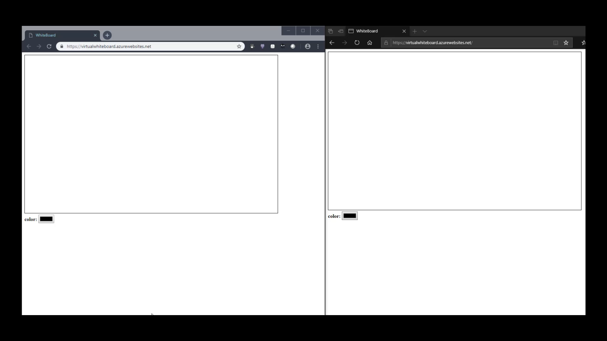
Virtual whiteboard example

Slide 6
Create your first ASP.NET Core SignalR app 5 steps to success

Slide 7

Step 1: Install server bits
Microsoft.AspNetCore.App
Microsoft.AspNetCore
.SignalR
Microsoft.AspNetCore
.SignalR.Common
Microsoft.AspNetCore
.SignalR.Core
Microsoft.AspNetCore
.SignalR.Protocols.Json
Metapackage installs ALL THE THINGS
Notes:
This assumes .NET Core target framework

Slide 8

Step 2: Startup configuration
Add SignalR services
Add SignalR middleware
Map each Hub to a route
Startup.cs
public void ConfigureServices( IServiceCollection services) { services.AddSignalR(); }
Startup.cs
public void Configure( IApplicationBuilder app) { app.UseSignalR(routes => { routes.MapHub<ChatHub>("/chatHub"); }); }

Slide 9
Step 3: Hub creation
C# class deriving from Hub
Client connects to Hub, invokes public methods
Each Hub is a separate “copy” of SignalR
ChatHub.cs
using Microsoft.AspNetCore.SignalR; public class ChatHub : Hub { public void Send(string user, string message) { // Call broadcastMessage to update clients Clients.All.SendAsync("broadcastMessage", user, message); } }
Notes:
- Hub registration in Startup.Configure
- Strongly typed Hubs avoid magic strings
- broadcastMessage = method server calls on client

Slide 10




Step 4: Install client bits
 | Microsoft.AspNetCore.SignalR.Client
 | > npm install @aspnet/signalr
 | UNPKG > libman install @aspnet/signalr -p unpkg -d wwwroot/lib/signalr --files dist/browser/signalr.js --files dist/browser/signalr.min.js
Notes:
Support for LibMan as of VS 2017 15.8

Slide 11

Step 5: Consumption via client
chat.js
// Create the connection const connection = new signalR.HubConnectionBuilder() .withUrl('/chatHub') .build(); // Create a function the Hub can call to broadcast messages connection.on('broadcastMessage', (name, message) => { // Add the message to the page let listItem = document.createElement('li'); listItem.innerHTML = `<strong>${name}</strong>: ${message}`; document.getElementById('discussion').appendChild(listItem); }); connection.start().catch(err => console.error(err.toString()));
Notes:
JavaScript client

Slide 12
Scale-out for your ASP.NET Core SignalR app

Slide 13
Scale-out with SignalR
Necessity with a server farm
Actions on 1 server need to be known to other servers
Handled by backplane
Connected clients
SignalR app instance 1
Redis
SignalR app instance 2
Notes:
- SQL Server not an option, as it was in ASP.NET 4.x
- Redis = backplane
- Need to setup your own Redis server/cluster
- When instance 1 wants to broadcast messages to ALL connected clients, it only knows about the clients connected to it.

Slide 14

A weak scale-out solution
Azure App Service
ASP.NET
Core app
Pages
Hubs
Web
traffic
SignalR
traffic
Client
Notes:
All traffic hits the same app
App Service limits the # of concurrent connections (SignalR Service solves this)

Slide 15
A better scale-out solution
Azure App Service Azure SignalR Service
ASP.NET
Core app
Pages
Hubs
Server endpoint
Client endpoint
Web
traffic
SignalR
traffic
Client
Notes:
All traffic hits the same app
App Service limits the # of concurrent connections (SignalR Service solves this)

Slide 16


Concurrent connections in Azure
Azure App Service
3 Basic instances = 1,050 concurrent
@ ~$0.23 / hr.
Azure SignalR Service
3 Standard instances = 3,000 concurrent
@ ~$0.10 / hr.
Tier | Connections / instance | Max. instances | Price / instance / hr.
Azure App Service
Free | 5 | 1 | $0.00
Shared | 35 | 1 | $0.013
Basic | 350 | 3 | $0.075
Standard | Unlimited | 10 | $0.10
Premium | Unlimited | 20 | $0.20
Isolated | Unlimited | 100 | $0.40
Azure SignalR Service
Free | 20 | 1 | $0.00
Standard | 1,000 | 100 | $0.0335
Messages / instance / day
20,000
1,000,000
Notes:
Recommend SignalR Service for PROD workloads
3 million msgs. / day w/ 3 Standard instances

Slide 17
Azure SignalR Service: Startup configuration
Connection string storage:
Development: Secret Manager
Production: Azure Key Vault
Startup.cs
public void ConfigureServices( IServiceCollection services) { services.AddSignalR .AddAzureSignalR(); // Longer form below // // services.AddSignalR() // .AddAzureSignalR(Configuration[ // "Azure:SignalR:ConnectionString"]); }
Startup.cs
public void Configure( IApplicationBuilder app) { app.UseAzureSignalR(routes => { routes.MapHub<ChatHub>("/chatHub"); }); }
Notes:
Get SignalR Service conn. string from Keys blade in Azure Portal

Slide 18



Resources @Scott_Addie
Docs
Slides
Sample Apps
➔
docs.microsoft.com/aspnet/core/signalr
➔
docs.microsoft.com/azure/azure-signalr
➔
aka.ms/nop-signalr-slides
➔
github.com/aspnet/SignalR-samples
➔
github.com/scottaddie/VirtualWhiteBoard

